Slide 1
IOMU 2027 Logo Concepts
19th Indonesian Occupational Medicine Updates · Solo · PERDOKI
Three candidates for voting · Palette: Emerald Green & Gold

Slide 2
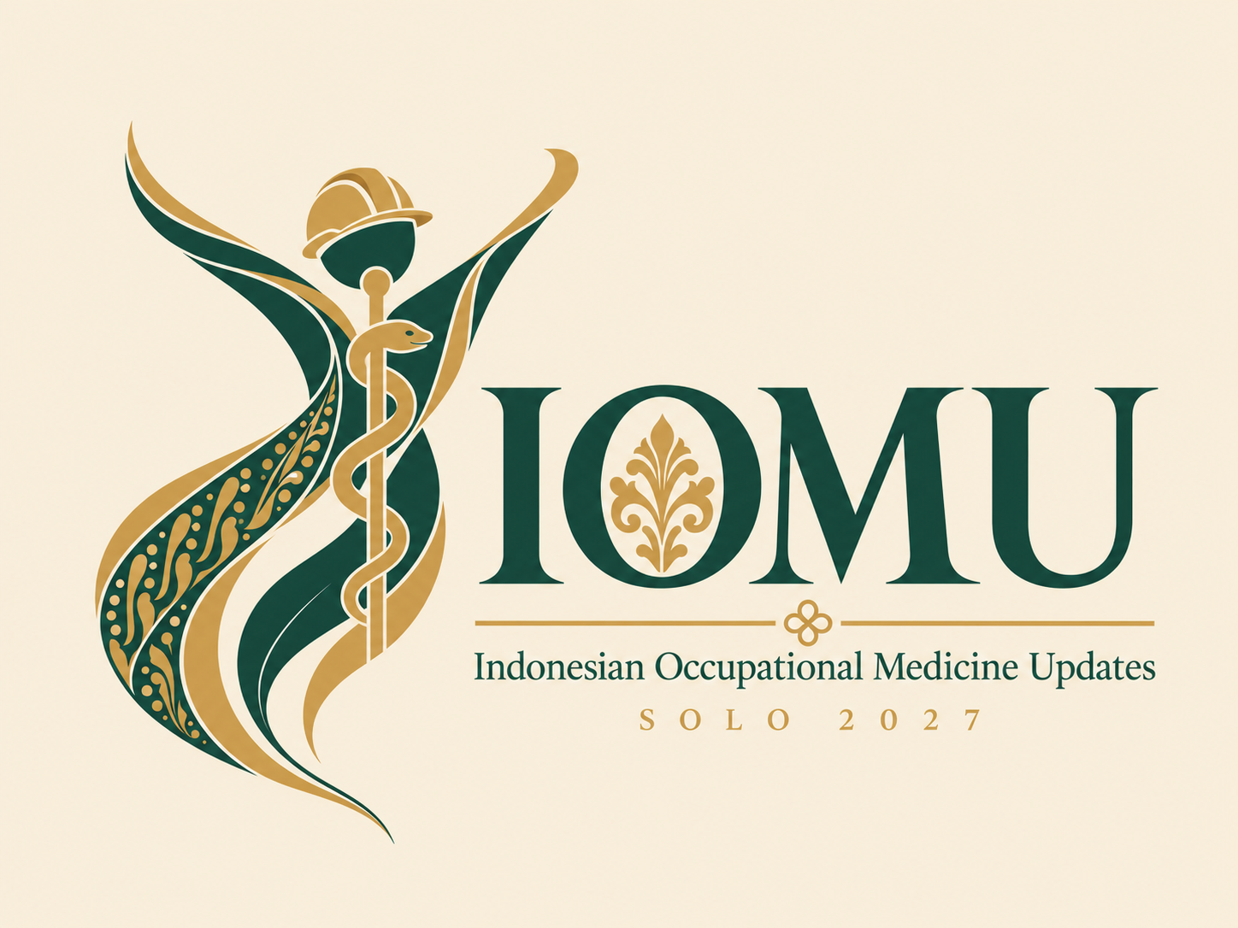
Concept 1 · Healthy Worker
Figure: An abstract worker with arms raised: a healthy, thriving workforce
Hard-hat head: Occupational safety and the worker as the centre of the specialty
Rod of Asclepius: Medicine, forming the figure's backbone
Batik ribbon: Solo batik in flowing emerald and gold bands
Ornament in the O: Gold crest ornament inspired by Javanese carving
Serif wordmark: Classic, formal, matches a scientific meeting
Concept draft, AI-generated. The chosen logo will be redrawn as a clean vector file.

Slide 3
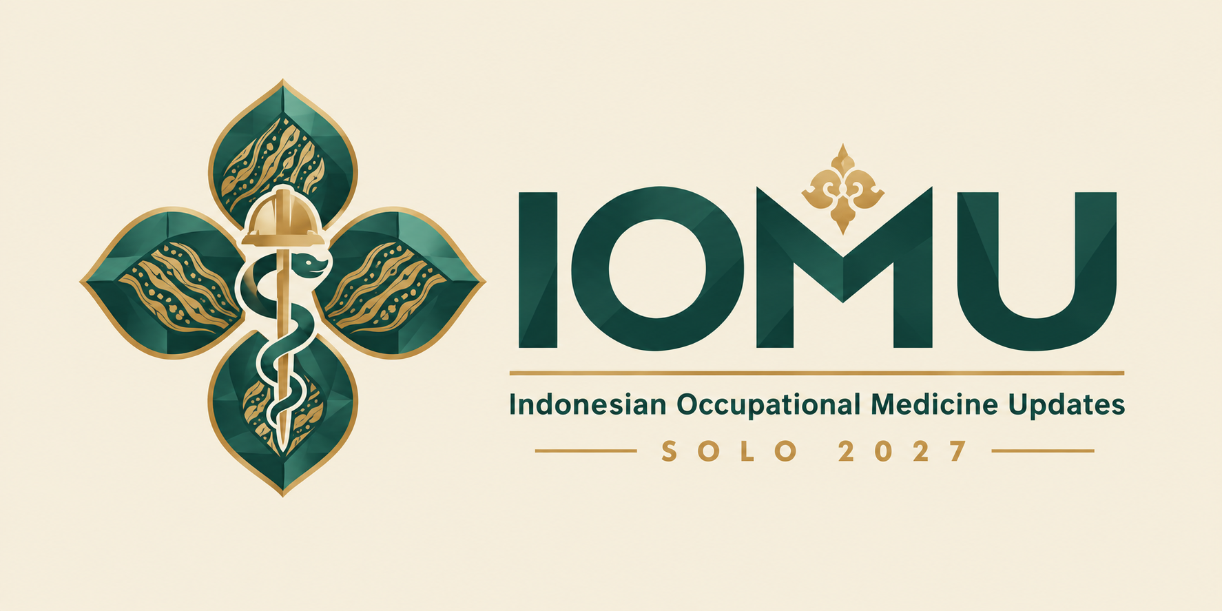
Concept 2 · Kawung Cross
Four kawung petals: Arranged as a medical cross: health built on Javanese heritage
Batik engraving: Parang pattern inside each petal
Hard hat + rod: Occupational safety and medicine at the centre
Crest above the M: Ornament inspired by the carved crest of Keraton Surakarta
Sans-serif wordmark: Modern, strong, highly legible at small sizes
Concept draft, AI-generated. The chosen logo will be redrawn as a clean vector file.

Slide 4
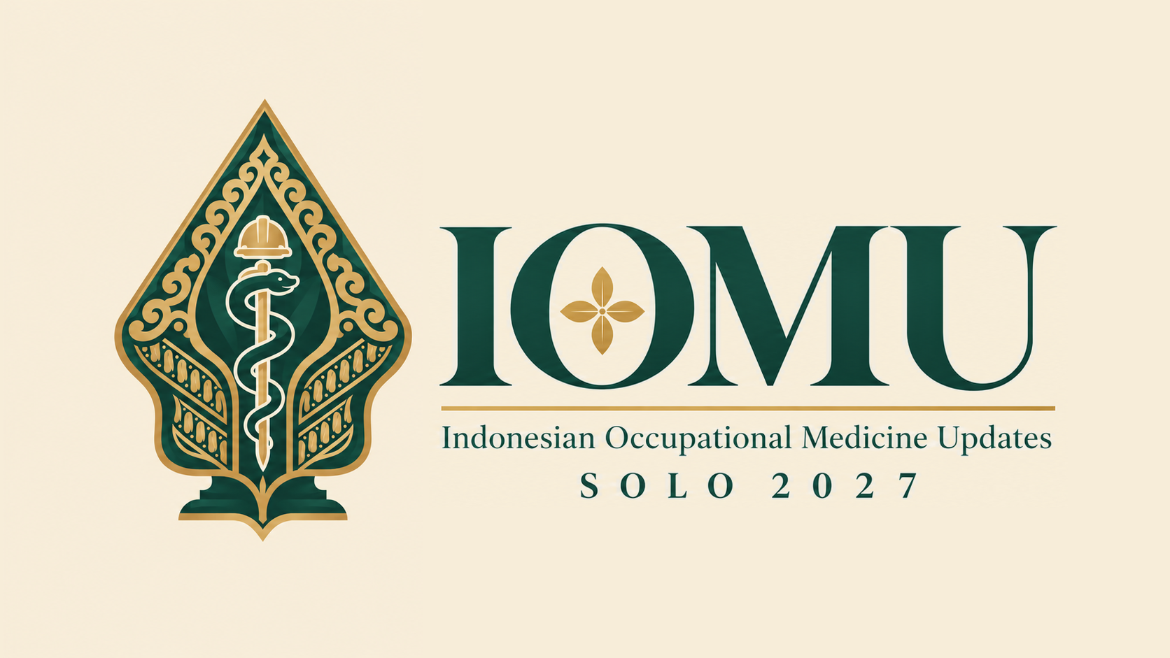
Concept 3 · Gunungan
Gunungan: Wayang kulit tree of life; Solo is a centre of wayang tradition
Hard hat + rod: Occupational safety and medicine inside the gunungan
Batik bands: Parang engraving with gold scrollwork
Kawung in the O: Solo batik; order and integrity
Serif wordmark: Classic, formal, matches a scientific meeting
Concept draft, AI-generated. The chosen logo will be redrawn as a clean vector file.

Slide 5
Vote: which logo for IOMU 2027?
1 · Healthy Worker
2 · Kawung Cross
3 · Gunungan
Concept draft, AI-generated. The chosen logo will be redrawn as a clean vector file.

